Slide 1

MIRROR IMAGE
In this question you are given a combination of alphabets and/or numbers followed by four alternatives (1), (2), (3) and (4). Choose the alternative which is closely resembles the mirror image of the given combination.
Q 1.

Slide 2
MIRROR IMAGE
In this question you are given a combination of alphabets and/or numbers followed by four alternatives (1), (2), (3) and (4). Choose the alternative which is closely resembles the mirror image of the given combination.
Q 1.

Slide 3

MIRROR IMAGE
In this question you are given a combination of alphabets and/or numbers followed by four alternatives (1), (2), (3) and (4). Choose the alternative which is closely resembles the mirror image of the given combination.
Q 2.

Slide 4
MIRROR IMAGE
In this question you are given a combination of alphabets and/or numbers followed by four alternatives (1), (2), (3) and (4). Choose the alternative which is closely resembles the mirror image of the given combination.
Q 2.

Slide 5
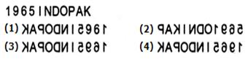
MIRROR IMAGE
In this question you are given a combination of alphabets and/or numbers followed by four alternatives (1), (2), (3) and (4). Choose the alternative which is closely resembles the mirror image of the given combination.
Q 3.

Slide 6
MIRROR IMAGE
In this question you are given a combination of alphabets and/or numbers followed by four alternatives (1), (2), (3) and (4). Choose the alternative which is closely resembles the mirror image of the given combination.
Q 3.

Slide 7
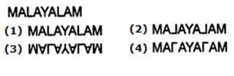
MIRROR IMAGE
In this question you are given a combination of alphabets and/or numbers followed by four alternatives (1), (2), (3) and (4). Choose the alternative which is closely resembles the mirror image of the given combination.
Q 4.

Slide 8
MIRROR IMAGE
In this question you are given a combination of alphabets and/or numbers followed by four alternatives (1), (2), (3) and (4). Choose the alternative which is closely resembles the mirror image of the given combination.
Q 4.

Slide 9
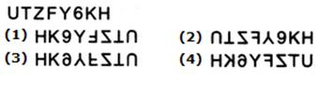
MIRROR IMAGE
In this question you are given a combination of alphabets and/or numbers followed by four alternatives (1), (2), (3) and (4). Choose the alternative which is closely resembles the mirror image of the given combination.
Q 5.

Slide 10
MIRROR IMAGE
In this question you are given a combination of alphabets and/or numbers followed by four alternatives (1), (2), (3) and (4). Choose the alternative which is closely resembles the mirror image of the given combination.
Q 5.

Slide 11
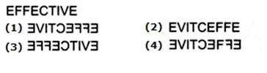
MIRROR IMAGE
In this question you are given a combination of alphabets and/or numbers followed by four alternatives (1), (2), (3) and (4). Choose the alternative which is closely resembles the mirror image of the given combination.
Q 6.

Slide 12
MIRROR IMAGE
In this question you are given a combination of alphabets and/or numbers followed by four alternatives (1), (2), (3) and (4). Choose the alternative which is closely resembles the mirror image of the given combination.
Q 6.

Slide 13
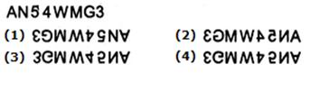
MIRROR IMAGE
In this question you are given a combination of alphabets and/or numbers followed by four alternatives (1), (2), (3) and (4). Choose the alternative which is closely resembles the mirror image of the given combination.
Q 7.

Slide 14
MIRROR IMAGE
In this question you are given a combination of alphabets and/or numbers followed by four alternatives (1), (2), (3) and (4). Choose the alternative which is closely resembles the mirror image of the given combination.
Q 7.

Slide 15
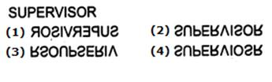
MIRROR IMAGE
In this question you are given a combination of alphabets and/or numbers followed by four alternatives (1), (2), (3) and (4). Choose the alternative which is closely resembles the mirror image of the given combination.
Q 8.

Slide 16
MIRROR IMAGE
In this question you are given a combination of alphabets and/or numbers followed by four alternatives (1), (2), (3) and (4). Choose the alternative which is closely resembles the mirror image of the given combination.
Q 8.

Slide 17
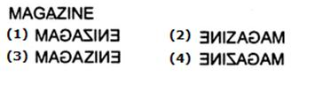
MIRROR IMAGE
In this question you are given a combination of alphabets and/or numbers followed by four alternatives (1), (2), (3) and (4). Choose the alternative which is closely resembles the mirror image of the given combination.
Q 9.

Slide 18
MIRROR IMAGE
In this question you are given a combination of alphabets and/or numbers followed by four alternatives (1), (2), (3) and (4). Choose the alternative which is closely resembles the mirror image of the given combination.
Q 9.

Slide 19

MIRROR IMAGE
In this question you are given a combination of alphabets and/or numbers followed by four alternatives (1), (2), (3) and (4). Choose the alternative which is closely resembles the mirror image of the given combination.
Q 10.

Slide 20
MIRROR IMAGE
In this question you are given a combination of alphabets and/or numbers followed by four alternatives (1), (2), (3) and (4). Choose the alternative which is closely resembles the mirror image of the given combination.
Q 10.

Slide 21

MIRROR IMAGE
In this question you are given a combination of alphabets and/or numbers followed by four alternatives (1), (2), (3) and (4). Choose the alternative which is closely resembles the mirror image of the given combination.
Q 11.

Slide 22
MIRROR IMAGE
In this question you are given a combination of alphabets and/or numbers followed by four alternatives (1), (2), (3) and (4). Choose the alternative which is closely resembles the mirror image of the given combination.
Q 11.

Slide 23
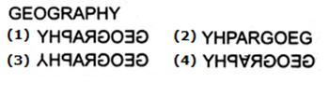
MIRROR IMAGE
In this question you are given a combination of alphabets and/or numbers followed by four alternatives (1), (2), (3) and (4). Choose the alternative which is closely resembles the mirror image of the given combination.
Q 12.

Slide 24
MIRROR IMAGE
In this question you are given a combination of alphabets and/or numbers followed by four alternatives (1), (2), (3) and (4). Choose the alternative which is closely resembles the mirror image of the given combination.
Q 12.

Slide 25
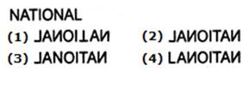
MIRROR IMAGE
In this question you are given a combination of alphabets and/or numbers followed by four alternatives (1), (2), (3) and (4). Choose the alternative which is closely resembles the mirror image of the given combination.
Q 13.

Slide 26
MIRROR IMAGE
In this question you are given a combination of alphabets and/or numbers followed by four alternatives (1), (2), (3) and (4). Choose the alternative which is closely resembles the mirror image of the given combination.
Q 13.

Slide 27
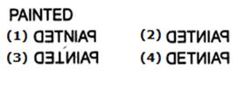
MIRROR IMAGE
In this question you are given a combination of alphabets and/or numbers followed by four alternatives (1), (2), (3) and (4). Choose the alternative which is closely resembles the mirror image of the given combination.
Q 14.

Slide 28
MIRROR IMAGE
In this question you are given a combination of alphabets and/or numbers followed by four alternatives (1), (2), (3) and (4). Choose the alternative which is closely resembles the mirror image of the given combination.
Q 14.

Slide 29
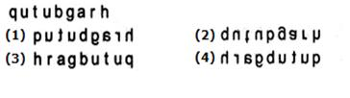
MIRROR IMAGE
In this question you are given a combination of alphabets and/or numbers followed by four alternatives (1), (2), (3) and (4). Choose the alternative which is closely resembles the mirror image of the given combination.
Q 15.

Slide 30
MIRROR IMAGE
In this question you are given a combination of alphabets and/or numbers followed by four alternatives (1), (2), (3) and (4). Choose the alternative which is closely resembles the mirror image of the given combination.
Q 15.

Slide 31
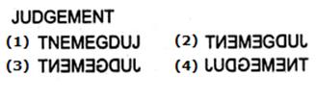
MIRROR IMAGE
In this question you are given a combination of alphabets and/or numbers followed by four alternatives (1), (2), (3) and (4). Choose the alternative which is closely resembles the mirror image of the given combination.
Q 16.

Slide 32
MIRROR IMAGE
In this question you are given a combination of alphabets and/or numbers followed by four alternatives (1), (2), (3) and (4). Choose the alternative which is closely resembles the mirror image of the given combination.
Q 16.

Slide 33
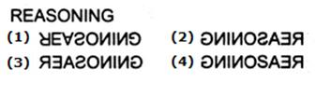
MIRROR IMAGE
In this question you are given a combination of alphabets and/or numbers followed by four alternatives (1), (2), (3) and (4). Choose the alternative which is closely resembles the mirror image of the given combination.
Q 17.

Slide 34
MIRROR IMAGE
In this question you are given a combination of alphabets and/or numbers followed by four alternatives (1), (2), (3) and (4). Choose the alternative which is closely resembles the mirror image of the given combination.
Q 17.

Slide 35
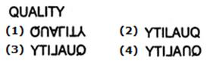
MIRROR IMAGE
In this question you are given a combination of alphabets and/or numbers followed by four alternatives (1), (2), (3) and (4). Choose the alternative which is closely resembles the mirror image of the given combination.
Q 18.

Slide 36
MIRROR IMAGE
In this question you are given a combination of alphabets and/or numbers followed by four alternatives (1), (2), (3) and (4). Choose the alternative which is closely resembles the mirror image of the given combination.
Q 18.

Slide 37
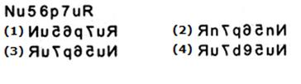
MIRROR IMAGE
In this question you are given a combination of alphabets and/or numbers followed by four alternatives (1), (2), (3) and (4). Choose the alternative which is closely resembles the mirror image of the given combination.
Q 19.

Slide 38
MIRROR IMAGE
In this question you are given a combination of alphabets and/or numbers followed by four alternatives (1), (2), (3) and (4). Choose the alternative which is closely resembles the mirror image of the given combination.
Q 19.

Slide 39
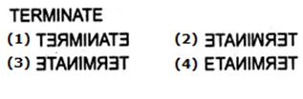
MIRROR IMAGE
In this question you are given a combination of alphabets and/or numbers followed by four alternatives (1), (2), (3) and (4). Choose the alternative which is closely resembles the mirror image of the given combination.
Q 20.

Slide 40
MIRROR IMAGE
In this question you are given a combination of alphabets and/or numbers followed by four alternatives (1), (2), (3) and (4). Choose the alternative which is closely resembles the mirror image of the given combination.
Q 20.

Slide 41
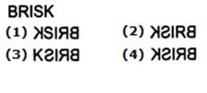
MIRROR IMAGE
In this question you are given a combination of alphabets and/or numbers followed by four alternatives (1), (2), (3) and (4). Choose the alternative which is closely resembles the mirror image of the given combination.
Q 21.

Slide 42
MIRROR IMAGE
In this question you are given a combination of alphabets and/or numbers followed by four alternatives (1), (2), (3) and (4). Choose the alternative which is closely resembles the mirror image of the given combination.
Q 21.

Slide 43

MIRROR IMAGE
In this question you are given a combination of alphabets and/or numbers followed by four alternatives (1), (2), (3) and (4). Choose the alternative which is closely resembles the mirror image of the given combination.
Q 22.

Slide 44
MIRROR IMAGE
In this question you are given a combination of alphabets and/or numbers followed by four alternatives (1), (2), (3) and (4). Choose the alternative which is closely resembles the mirror image of the given combination.
Q 22.

Slide 45
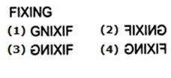
MIRROR IMAGE
In this question you are given a combination of alphabets and/or numbers followed by four alternatives (1), (2), (3) and (4). Choose the alternative which is closely resembles the mirror image of the given combination.
Q 23.

Slide 46
MIRROR IMAGE
In this question you are given a combination of alphabets and/or numbers followed by four alternatives (1), (2), (3) and (4). Choose the alternative which is closely resembles the mirror image of the given combination.
Q 23.

Slide 47
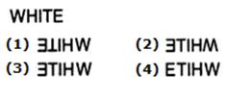
MIRROR IMAGE
In this question you are given a combination of alphabets and/or numbers followed by four alternatives (1), (2), (3) and (4). Choose the alternative which is closely resembles the mirror image of the given combination.
Q 24.

Slide 48
MIRROR IMAGE
In this question you are given a combination of alphabets and/or numbers followed by four alternatives (1), (2), (3) and (4). Choose the alternative which is closely resembles the mirror image of the given combination.
Q 24.

